Slide 1
Cont ..
TEST CASE PREPARATION

Slide 2
What you will come across in this session
A brief on Test Script
Components on a Test Script
Advantages of Test Script
Importance of linking the Test Scripts to RTM
Practical Exercise
Queries

Slide 3
What is Test Script?
A Test Script is a set of instructions that is performed on a system under test to verify that the system performs as expected.
Test Script defines the actions and pass/fail criteria. For example, if the action is "to enter a valid account number," the expected result is that the data are accepted. Entering an invalid number should yield a particular error message.
Test Script ensures:
Quality Product
Ensures both positive and negative scenarios
Delivering product meets requirements

Slide 4
Components on a Test Script
Feature ID: specifies the feature identifier
Requirement ID: specifies the requirement identifier
Requirement Description: specifies the requirement details
Test Case ID: specifies the Test case identifier
Test Case Description: specifies the Test Case details
Expected Result: specifies the results expected from that functionality
Actual Result: specifies the results what we get from our product
Status: specifies the status of particular Test Case
Bug ID: linking the Bug ID related to the Test Case

Slide 5

Advantages of Test Script
To cover all the functionalities.
You can find black holes of your product which aren’t mismatched with user stories/requirements.
Possibility for deliver of a high quality software product.
Simulating 'real' end user scenarios
Verifying conformance to applicable standards and guidelines and customer requirements

Slide 6
Importance of linking the Test Scripts to RTM
RTM links a business requirement to its corresponding functional requirement right up to the corresponding test cases.
If a Test Case fails, traceability helps determine the corresponding functionality easily .
Very easy to track the test cases that are affected.
Verify that an implementation fulfills all requirements: Everything that the customer requested was implemented
If we missed any test cases for the requirements at that time we can find out easy for what test cases missed for the what functionality by preparing the traceability matrix.

Slide 7
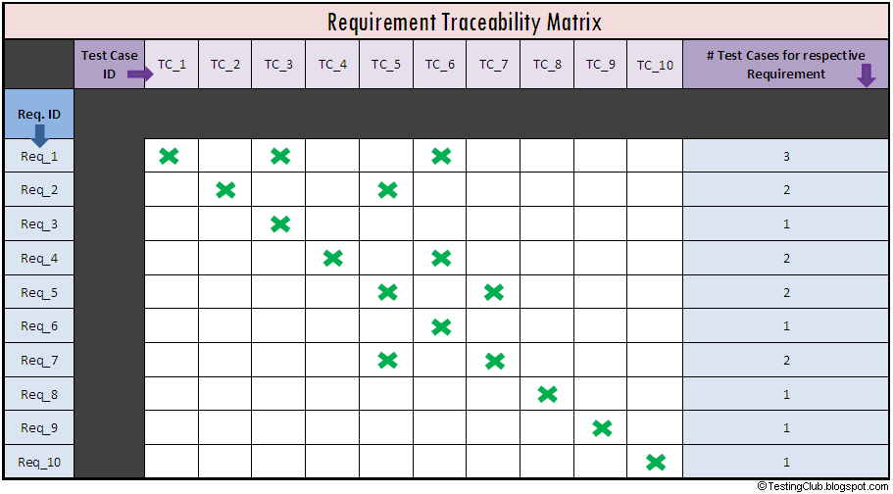
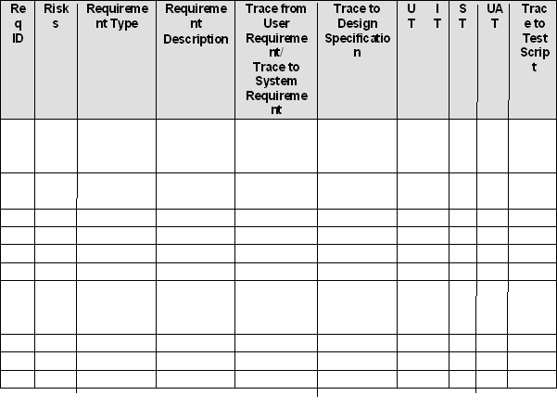

Slide 8
Practical Exercise
Go to the website www.gmail.com
Prepare the Test Script for Sign Up, Login functionality
Send it across to mabraham@suyati.com with your name.

Slide 9

Queries

